Slide 1
EPIBIOS Rodent MRI Analysis
November 9, 2020
Ryan Cabeen

Slide 2
Approach
Use machine learning instead of hypothesis testing
Classification with elastic net logistic regression
Evaluate with cross validation
Identify important variables

Slide 3
Machine Learning-based Classification
Goal: Learn a function y = f(x) from data
y: outcome (TBI- vs TBI+)
x: imaging-derived variables
f: the function we learn
(with some parameterization)
How do we do this?

Slide 4


Logistic Regression Classification
vs.
Ordinary Linear Regression
Assumption: Outcome variable in linear combination of input variables
Logistic Regression
Assumption: Outcome is a probability with a log-likelihood that is a linear combination of input variables.

Slide 5
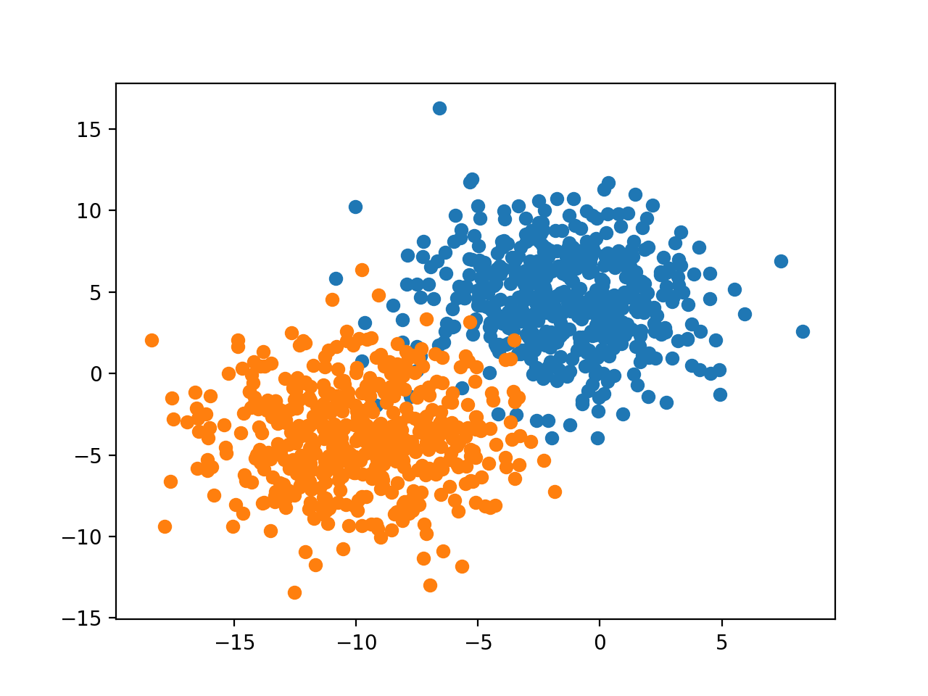
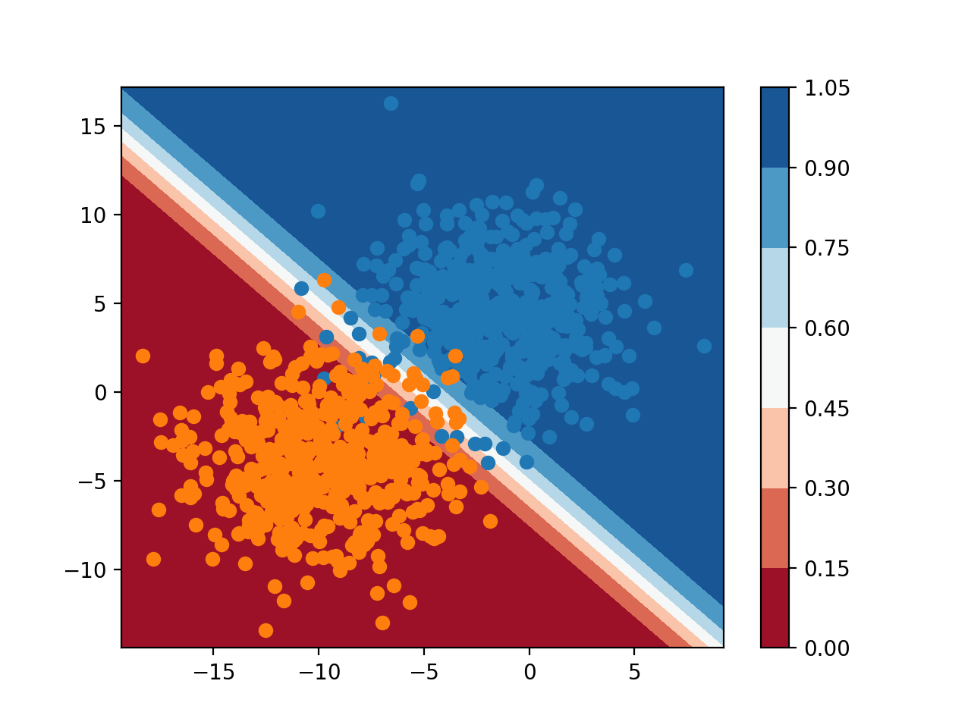
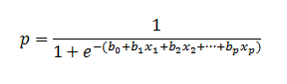
Multi-variate Logistic Regression Classification

Slide 6
Regularization
Problem: the model is ill-posed when the number of variables is greater than the number of observations. This means an infinite set of model parameters exists that solve the classification problem.
Solution: use regularization to constrain the solution space. Considerations include: keeping the model interpretable, minimizing the bias and overfitting

Slide 7
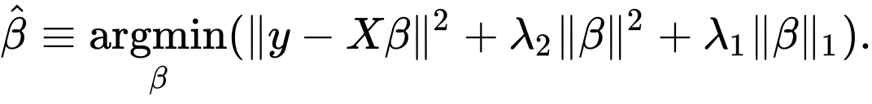
Elastic-net Regularization
Combines two types of regularization:
Model parameters
Prediction error
Ridge-style (L2) regularization
LASSO-style (L1) regularization
Ridge regularization: guides solution towards smaller magnitudes
LASSO regularization: guides solution towards sparse solutions (mostly zeros)
Elastic-net regularization: improved performance with correlated variables, improved optimization landscape. Generalizes L1 and L2 reg.

Slide 8
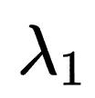
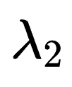
Elastic-net Regularization
Combines two types of regularization:
Model parameters
Prediction error
Ridge-style (L2) regularization
LASSO-style (L1) regularization
Simplification: choose = =
Implementation: R glmnet

Slide 9
Model Optimization and Evaluation
Two-level leave-one-out cross-validation (LOOCV):
Each level trains on a subset of data and tests on the remainder
Use over-sampling to handle class imbalance
Leave out both positive and negative examples in each loop
Inner loop: determine the optimal lambda
Outer loop: assess generalization
Model evaluation:
Compute average accuracy across outer loop
Fit a model with median lambda across outer loop to assess variables

Slide 10
Experiments
Build classifiers based on diffusion measures:
Whole bundle FA
Whole bundle volume, length, density
Evaluate classifiers for each site, and as a composite

Slide 11
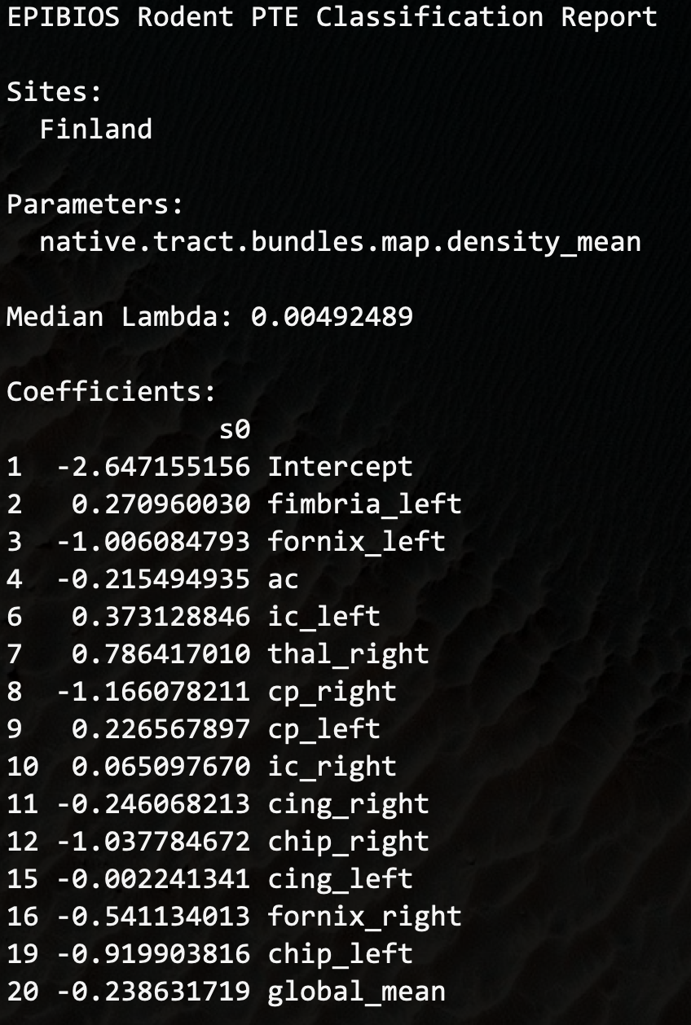
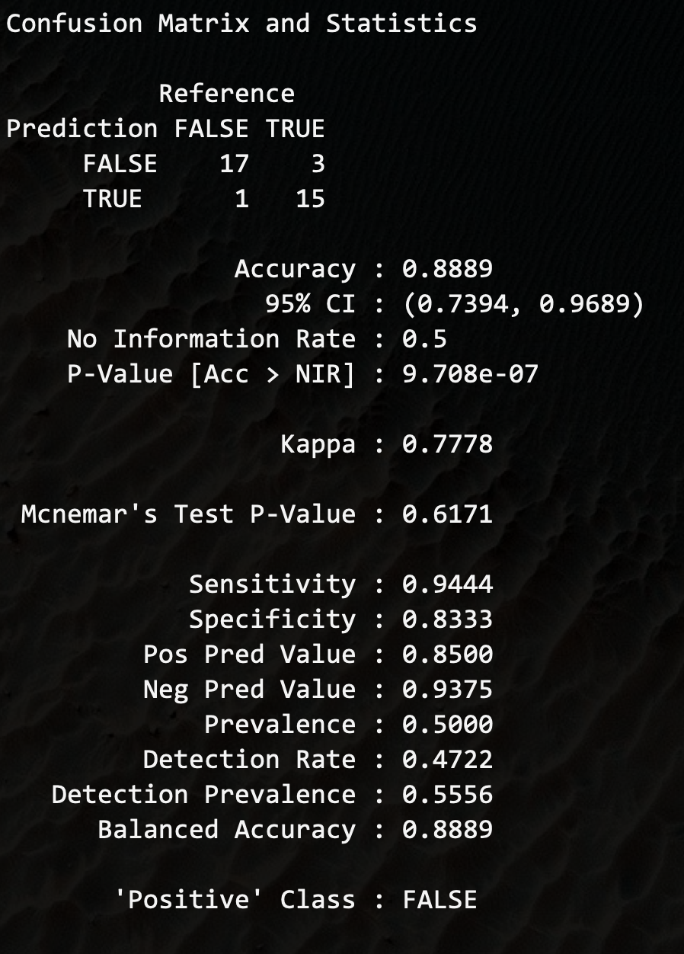

Slide 12
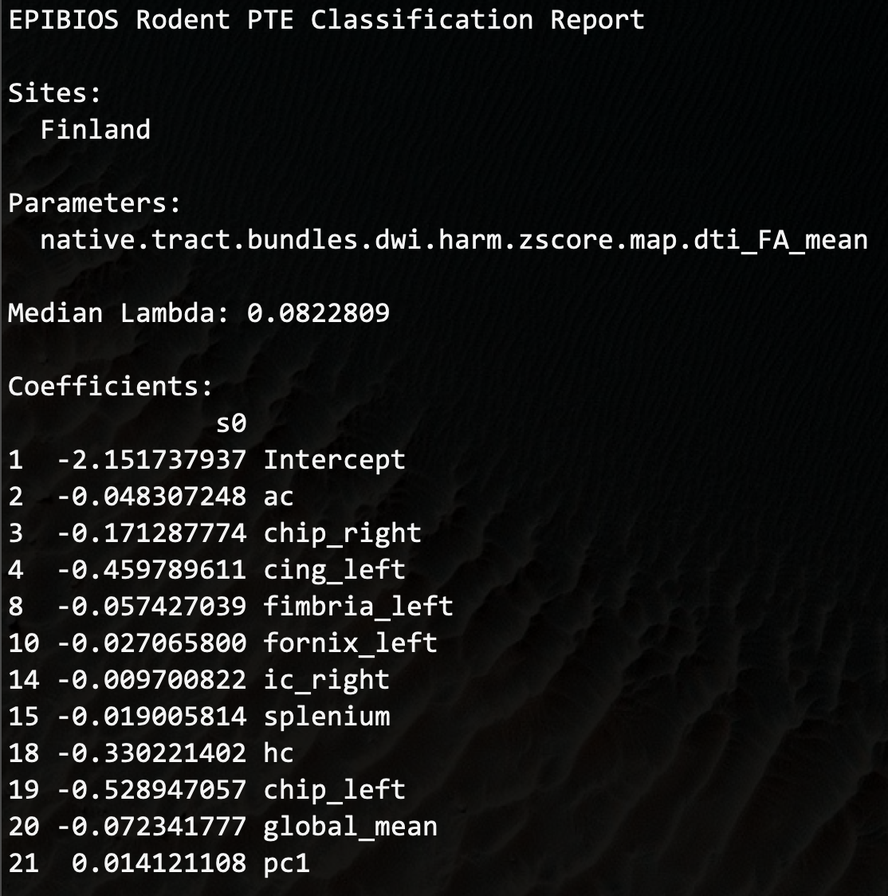
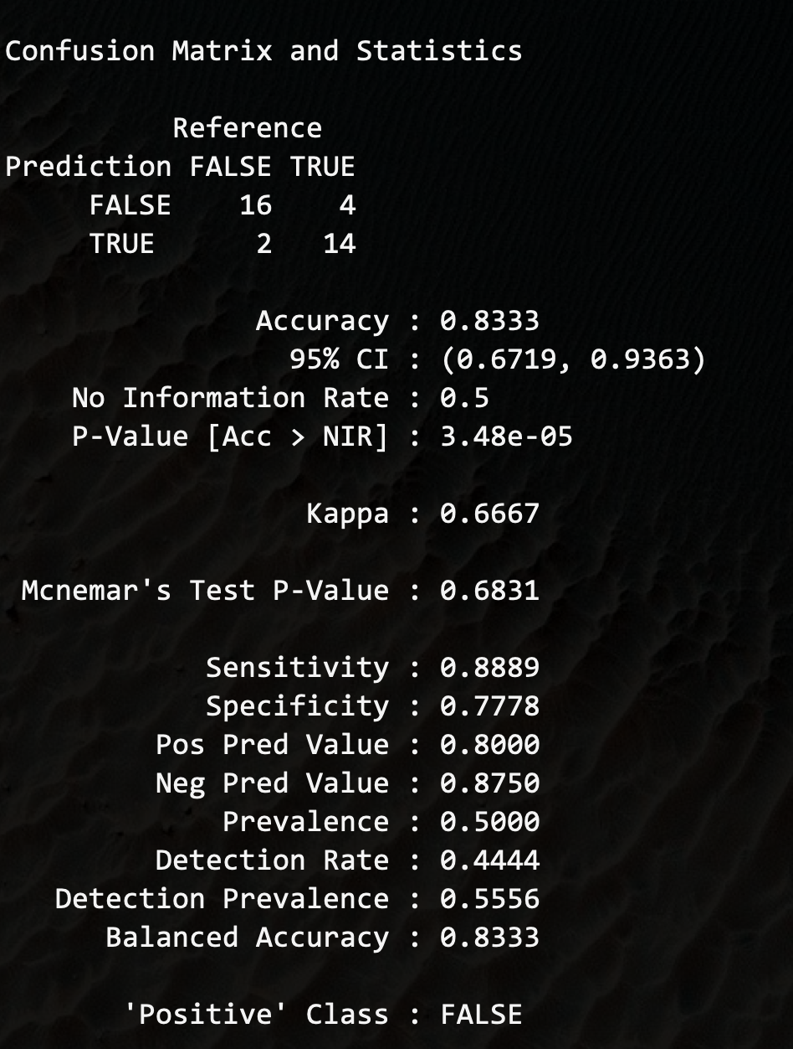

Slide 13
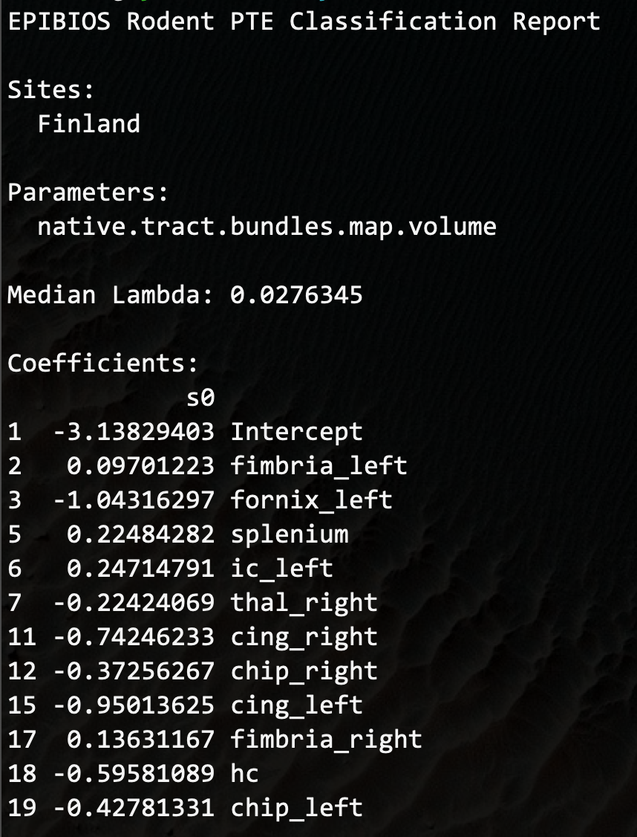
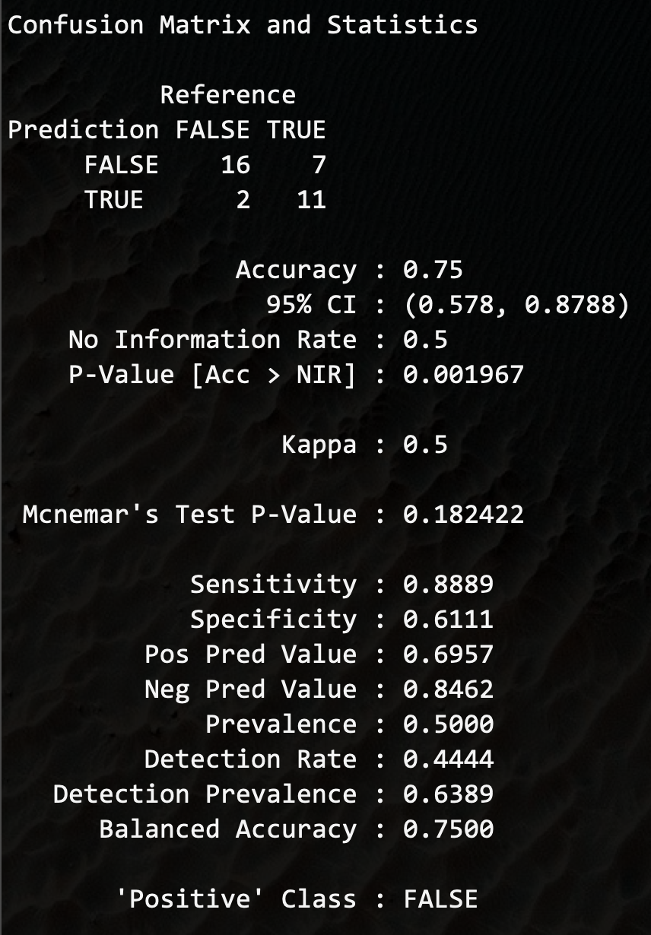

Slide 14
